Slide 1
C/C++ Programming in a UNIX Environment
CS 3376
Bhanu Kapoor, PhD
Department of Computer Science University of Texas, Dallas, TX bhanu.kapoor@utdallas.edu
Notes Week 03: Part II

Slide 2
Reading for Week 03
Chapter 2 and 3 of A Practical Guide to Linux® Commands, Editors, and Shell Programming, Third Edition. Mark G. Sobell.
Chapter 2: Getting Started
Chapter 3: The Utilities

Slide 3
Agenda
Getting Started with Linux
The Utilities

Slide 4
Getting Started with Linux
□ Objectives
Log in on a Linux system using the textual interface √
Describe the advantages of the textual interface
Correct typing mistakes on the command line
Use kill to abort program execution using the termination signal
Repeat and edit previous command lines
Understand the need to be careful when working with root privileges
Use man and info to display information about utilities
Use the ––help option to display information about a utility
Change your password from the command line

Slide 5
Command-Line Interface
Before GUI, UNIX and Linux only provided textual or command-line interface (CLI)
CLI may be more powerful
CLI may be more efficient
Fewer tasks running, make systems more
secure or less vulnerable
Write scripts using CLI
Customize tasks that need to be run frequently
Pseudographical Interface

Slide 6
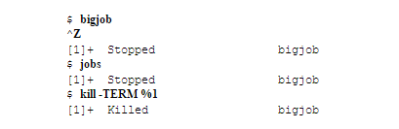
Terminating a Running Program
Use the interrupt (CONTROL-C or DEL)
Linux sends a TERM signal to program and to the shell
If this doesn’t work try CONTROL-\ which is a QUIT signal
If these don’t work, try CONTROL-Z which is suspend
Command jobs tells you about tasks running and suspended and you can kill a specific task

Slide 7
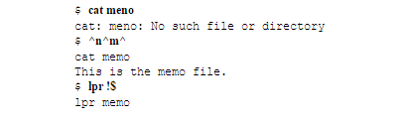
Repeating/Editing Command Lines
UP ARROW key to repeat previous command
DOWN ARROW to browse through commands
in other direction
Erase key to remove characters
Return key to run the command
Repeat previous command using !!
!$ is last word on previous command line

Slide 8
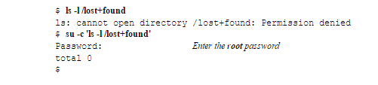
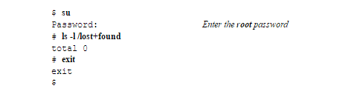
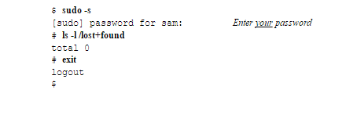
root Privileges

Slide 9
Command Documentation
man (manual) utility displays (man) pages from the system documentation
man man command gives documentation on man
$ man passwd
Manual Sections
User Commands
System Calls
Subroutines
Devices
File Formats
Games
Miscellaneous
System Administration
Kernel
New

Slide 10
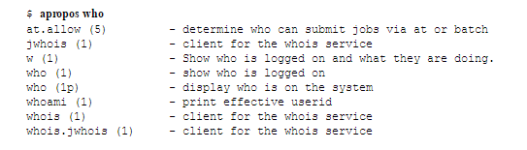

Searching Commands
apropos with a keyword to search
whatis utility is similar to apropos but finds only complete word matches

Slide 11
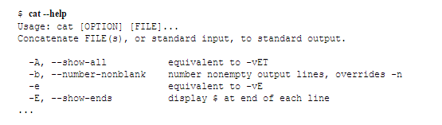
The –help Option
––help option that displays information about the utility
less may come handy

Slide 12
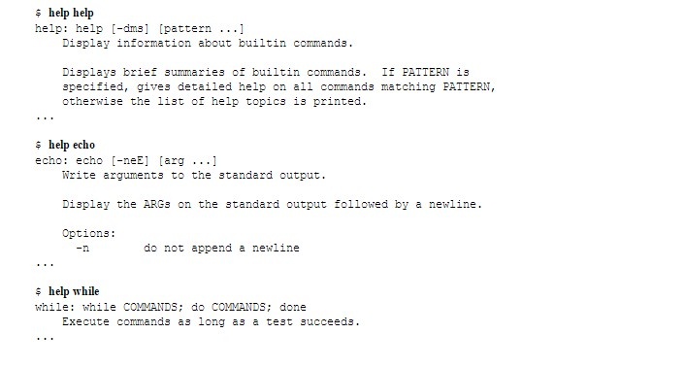
The help Command
□ bash help command displays information about bash commands

Slide 13
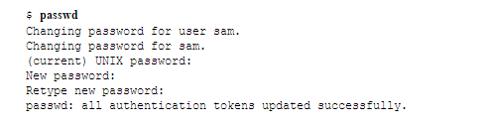
Changing Password
□ Passwd
CONTROL-D
exit

Slide 14
Questions
How would you display a list of utilities that compress files?
How would you repeat the preceding command line, edit it, and then execute it?
How would you change your login shell to tcsh and change back to bash?

Slide 15
Agenda
Getting Started with Linux
The Utilities

Slide 16
Utilities
Objectives
List special characters and methods of preventing
the shell from interpreting these characters
Use basic utilities to list files and display text files
Copy, move, and remove files
Search, sort, print, and compare text files
String commands together using a pipeline
Compress, decompress, and archive
Locate utilities on the system
Display information about users
Communicate with other users

Slide 17
Special Characters
Avoid using any of the following characters in a filename
□ & ; | * ? ' " ' [ ] ( ) $ < > { } # / \ ! ~
Whitespace
Backslash
Single quotation marks
$ echo 'xxxxxxCONTROL-U‘
$ echo xxxxxxCONTROL-V CONTROL-U \*
$ echo xxxxxxCONTROL-V CONTROL-U | od -c

Slide 18
Basic Utilities
□ $ ls
practice
$ cat practice
This is a small file that I created with a text editor.
$ rm practice
$ ls
$ cat practice
cat: practice: No such file or directory
cat: Displays a Text File
rm: deletes a file, rm –i safer way
less: display one screen page at a time

Slide 19
Basic Utilities
hostname: Displays the System Name
cp: Copies a File
$ ls
memo
$ cp memo memo.copy
$ ls
memo memo.copy
$ cp –i orange orange.2
cp: overwrite 'orange.2'? Y
mv: Changes the Name of a File
mv existing-filename new-filename

Slide 20
Basic Utilities
lpr: Prints a File
$ lpr report
$ lpr -P mailroom report
$ lpr -P laser1 05.txt 108.txt 12.txt
$ lpq
$ lprm 86
grep: Searches for a String
$ grep 'credit' memo

Slide 21
Basic Utilities
head: Displays the Beginning of a File
$ head months
$ head -1 months
tail: Displays the End of a File
$ tail -5 months
sort: Displays a File in Order
$ sort months
uniq: Removes Duplicate Lines from a File
$ uniq dups

Slide 22
Basic Utilities
diff: Compares Two Files
$ diff -u colors.1 colors.2
file: Identifies the Contents of a File
$ file memo zach.jpg
memo: ASCII text
zach.jpg: JPEG image data, ... resolution (DPI), 72 x 72
| (Pipeline): Communicates Between Processes
$ sort months | head -4
$ ls | wc -w

Slide 23
Basic Utilities
echo: Displays Text
$ ls
memo memo.0714 practice
$ echo Hi
Hi
$ echo This is a sentence.
This is a sentence.
$ echo star: *
star: memo memo.0714 practice
$ echo 'My new file.' > myfile
$ cat myfile
My new file.

Slide 24
Basic Utilities
□ date: Displays the Time and Date
$ date
Tue Apr 3 10:14:41 PDT 2012
$ date +"%A %B %d"
Tuesday April 03
□ script: Records a Shell Session
$ script
Script started, file is typescript
$ ls -l /bin | head -5
-rwxr-xr-x. 1 root root 123 02-07 $ exit
exit
Script done, file is typescript

Slide 25
Compressing and Archiving Files
gzip: Compresses a File
tar: Packs and Unpacks Archives
$ ls -l g b d
-rw-r--r--. 1 zach other 1178 08-20 14:16 b
-rw-r--r--. 1 zach zach 3783 08-20 14:17 d
-rw-r--r--. 1 zach zach 1302 08-20 14:16 g
$ tar -cvf all.tar g b d
g b d
$ ls -l all.tar
-rw-r--r--. 1 zach zach 9728 08-20 14:17 all.tar
$ tar -tvf all.tar
-rw-r--r-- zach /zach
-rw-r--r-- zach /other
-rw-r--r-- zach /zach
1302 2012-08-20 14:16 g
1178 2012-08-20 14:16 b
3783 2012-08-20 14:17 d

Slide 26
Uncompress
□ $ ls -l mak*
-rw-r--r--. 1 sam pubs 1712747 04-05 10:43 make-3.82.tar.gz
$ gunzip mak*
$ ls -l mak*
-rw-r--r--. 1 sam pubs 6338560 04-05 10:43 make-3.82.tar
$ tar -xvf mak*
make-3.82/
make-3.82/vmsfunctions.c make-3.82/getopt.h
make-3.82/make.1
...
make-3.82/README.OS2
make-3.82/remote-cstms.c
$ gunzip -c make-3.82.tar.gz | tar -xvf –
tar -xvzf make-3.82.tar.gz

Slide 27
Locating Utilities
which and whereis: Locate a Utility
$ which tar
/bin/tar
$ whereis tar
tar: /bin/tar
/usr/share/man/man1/tar.1.gz

Slide 28
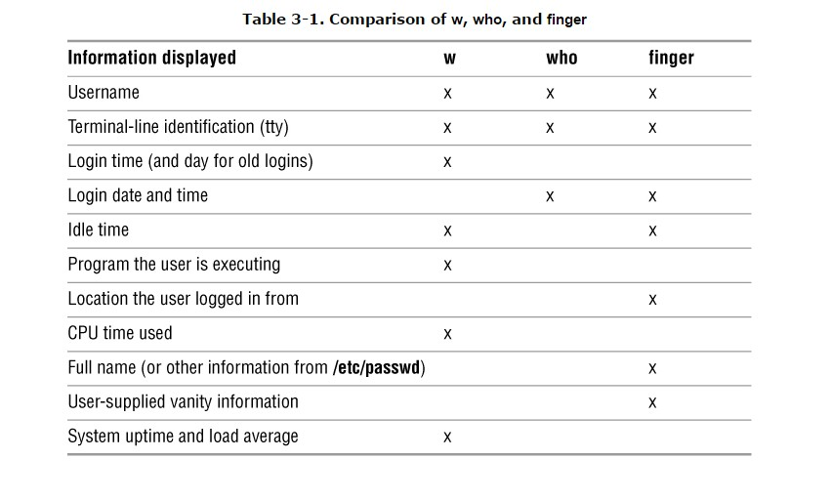
User and System Infromation

Slide 29
User and System Information
who: Lists Users on the System
$ who
$ who am I
finger: Lists Users on the System
$ finger
$ finger Simpson
uptime: Displays System Load and Duration Information
$uptime
w: Lists Users on the System

Slide 30
Communications
write: Sends a Message
$ write max
Hi Max, are you there? O
mesg: Denies or Accepts Messages
$ mesg y
$ write max

Slide 31
Questions
Which commands can you use to determine who is logged in on a specific terminal?
What happens when you give the following commands if the file named done already exists?
$ cp to_do done
$ mv to_do done
How can you find out which utilities are available on your system for editing files?
What happens when you use diff to compare two files?
What is the result of giving the which utility the name of a command that resides in a directory that is not in your search path?
Experiment by calling the file utility with the names of files in one of your directories. How many different types of files are there?
Use ls –l to determine the sizes of the files in your directory
How would you create a zipped tar file for one of your directories?

